Slide 1
Algorithm Complexity and Sorting Algorithms

Slide 2
Comparison of Algorithms
How do we compare the efficiency of different algorithms?
Comparing execution time: Too many assumptions, varies greatly between different computers
Compare number of instructions: Varies greatly due to different languages, compilers, programming styles...

Slide 3
Big-O Notation
The best way is to compare algorithms by the amount of work done in a critical loop, as a function of the number of input elements (N)
Big-O: A notation expressing execution time (complexity) as the term in a function that increases most rapidly relative to N
Consider the order of magnitude of the algorithm

Slide 4
Common Orders of Magnitude
O(1): Constant or bounded time; not affected by N at all
O(log₂N): Logarithmic time; each step of the algorithm cuts the amount of work left in half
O(N): Linear time; each element of the input is processed
O(N log₂N): N log₂N time; apply a logarithmic algorithm N times or vice versa

Slide 5
Common Orders of Magnitude (cont.)
O(N²): Quadratic time; typically apply a linear algorithm N times, or process every element with every other element
O(N³): Cubic time; naive multiplication of two NxN matrices, or process every element in a three-dimensional matrix
O(2^{N}): Exponential time; computation increases dramatically with input size

Slide 6
What About Other Factors?
Consider f(N) = 2N⁴ + 100N² + 10N + 50
We can ignore 100N² + 10N + 50 because 2N⁴ grows so quickly
Similarly, the 2 in 2N⁴ does not greatly influence the growth
The final order of magnitude is O(N⁴)
The other factors may be useful when comparing two very similar algorithms

Slide 7
Sorting Revisited
Sorting is a very common and useful operation
Efficient sorting algorithms can have large savings for many applications
The algorithms are evaluated on:
The number of comparisons made
The number of times data is moved
The amount of additional memory used

Slide 8
Sorting Efficiency
Worst Case: The data is in reverse order
Average Case: Random data, may be somewhat sorted already
Best Case: The array is already sorted
Typically, average and worst case performance are similar, if not identical
For many algorithms, the best case is also the same as the other cases

Slide 9
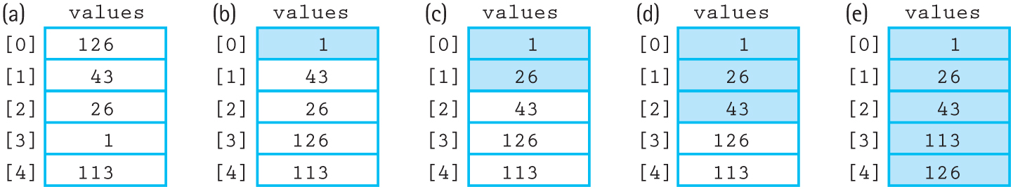
Straight Selection Sort
Set “current” to the first index of the array
Find the smallest value in the array
Swap the smallest value with the value in current
Increment current and repeat steps 2–4 until the end of the array is reached
Figure 12.1 Example of straight selection sort (sorted elements are shaded)

Slide 10
Analyzing Selection Sort
A very simple, easy-to-understand algorithm
N iterations are performed
Iteration I checks N – I items to find the next smallest value
There are N * (N – 1)/2 comparisons total
Therefore, selection sort is O(N²)
Even in the best case, it’s still O(N²)

Slide 11
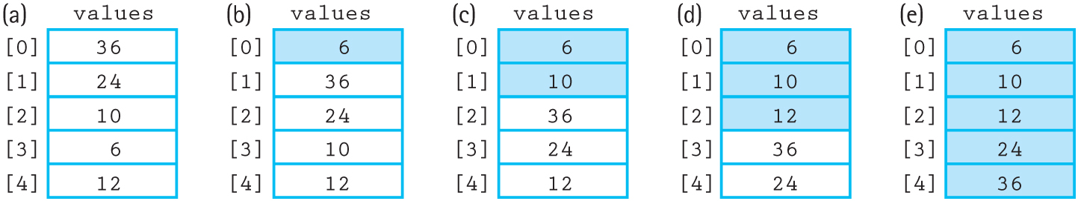
Bubble Sort
Set “current” to the first index of the array
For every index from the end of the list to 1, swap adjacent pairs of elements that are out of order
Increment current and repeat steps 2–3
Stop when current is at the end of the array
Figure 12.3 Example of bubble sort (sorted elements are shaded)

Slide 12
Bubble Sort
The name comes from how smaller elements “bubble up” to the top of the array
The inner loop compares values [index] < values [index-1], and swaps the two values if it evaluates to true
The smallest value is brought to the front of the unsorted portion of the array during iteration

Slide 13
Analyzing Bubble Sort
Takes N-1 iterations, because the last iteration puts two values in order
Each iteration I performs N-I comparisons
Bubble sort is therefore O(N²)
It may perform several swaps per iteration
Is the best case better? An already-sorted array needs only 1 iteration, so the base case is O(N)

Slide 14
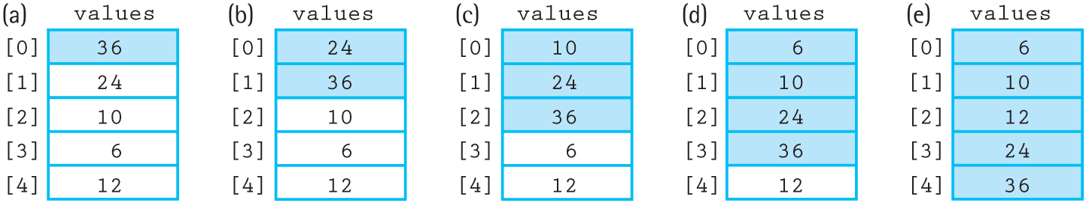
Insertion Sort
Acts like inserting elements into a sorted array, including moving elements down if necessary
Uses swapping (like Bubble Sort) to find the correct position of the next item
Figure 12.5 Example of the insertion sort algorithm

Slide 15
Analyzing Insertion Sort
O(N²), like the previous sorts
Best Case: O(N), since only one comparison is needed and no data is moved
O(N²) is not good enough when sorting large sets of data!

Slide 16
O(N log₂N) Sorts
Sorting a whole array is O(N²) with those sorts
Splitting the array in half, sorting it, and then merging the two arrays is (N/2)² + (N/2)²
This “divide-and-conquer” approach can then be applied to each half, giving O(N log₂N) sort

Slide 17
Merge Sort
Split the array in half
Recursively MergeSort the two halves
Merge the two halves
Base Case: Arrays of <2 elements are already sorted

Slide 18
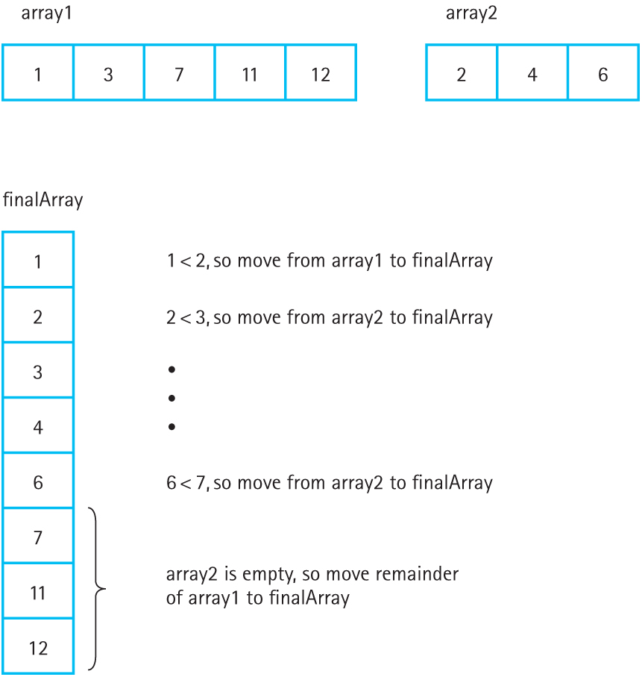
Merging
Figure 12.8 Strategy for merging two sorted arrays

Slide 19
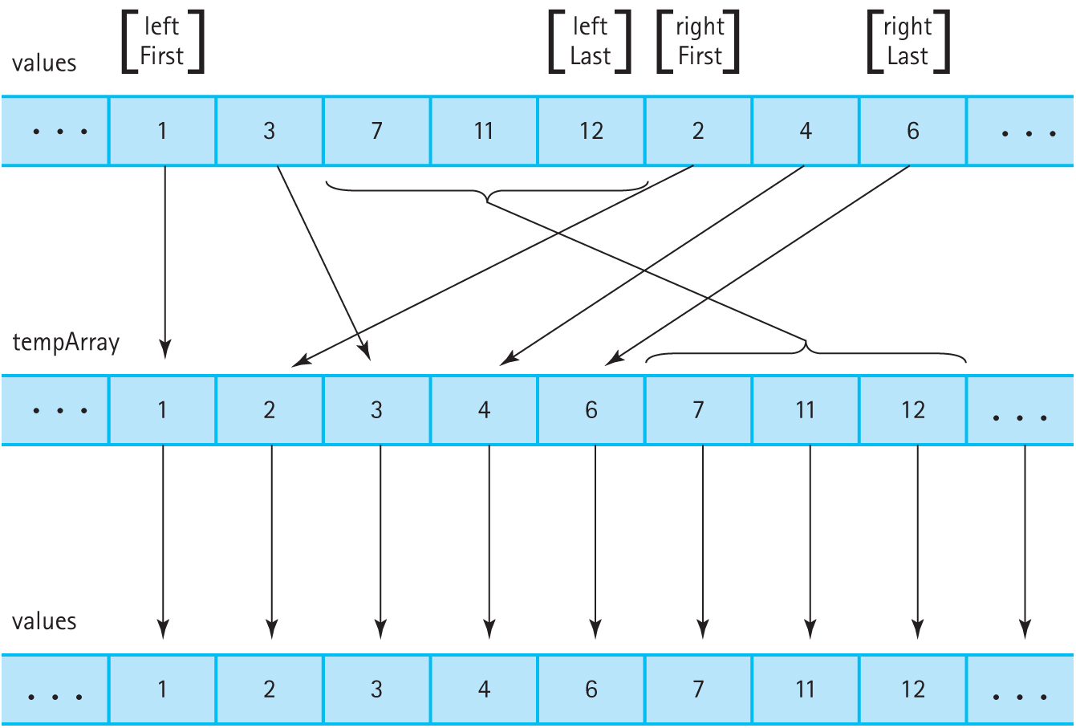
Merging (cont.)
Figure 12.10 Merging sorted halves

Slide 20
Merging Two Arrays
Simultaneously walk through both arrays
If itemA < itemB, copy itemA into the temp array and get the next item from A
If itemB < itemA, copy itemB into the temp array and get the next item from B
Stop when one of the arrays is empty; copy any remaining elements from the other array
Copy the temp array into the original array

Slide 21
Analyzing Merge Sort
The array is split into smaller and smaller arrays until it is finally split into 1- or 0-element arrays
Merging all of these 1-element arrays into 2-element arrays is O(N)
This O(N) merge repeats for each split, which happens log₂N times for O(N log₂N) total
However, merge sort requires O(N) additional memory to perform the merge

Slide 22
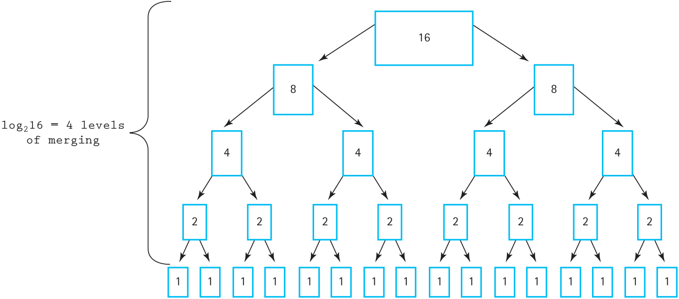
Merging Levels
Figure 12.11 Analysis of the function MergeSort with N = 16

Slide 23
Quick Sort
Choose a value from the array
Use this value to split the array into:
All the values that are less than or equal to the split
All the values that are greater than the split
Recursively quick sort the two subarrays
https://www.youtube.com/watch?v=3OLTJlwyIqQ

Slide 24
Analyzing Quick Sort
If the arrays are evenly split, log₂N splits are used and the algorithm is O(N log₂N)
If the array is not split evenly, the algorithm approaches O(N²)
Quick Sort may be inefficient if the data is already mostly sorted
O(log₂N) to O(N) additional memory needed, depending on the splits

Slide 25
Heap Sort
Turns the array into a heap, then places the root at the last unsorted slot of the array until the heap is depleted
Uses heap operations (ReheapDown) to find the next largest element in the heap

Slide 26
Analyzing Heap Sort
The overhead for building the heap is significant, O(N), and thus heap sort should be avoided for small arrays
ReheapDown is O(log₂N) and is called N times
The overall performance is O(N log₂N)
The initial order of the elements doesn’t matter
No additional space is needed

Slide 27
Other Considerations
Efficiency is not the only thing to consider when choosing which sorting algorithm to use
Big-O ignores constants and other factors, and in some situations O(N²) may grow slower than O(N log₂N)
Note: O(N log₂N) is the theoretical limit for sorting; it can’t get better than that!
But maybe we can improve the coefficients

Slide 28
Space Considerations
MergeSort requires an additional N memory
Depending on the implementation and the data, QuickSort may use O(N) memory
HeapSort is more algorithmically complex but uses no additional memory
Consider the memory constraints of the system and the size of the input when choosing

